Slide 1
Clean Code
Comments and Formatting
May 2020

Slide 2
Commenting
“Don’t comment bad code—rewrite it.”
—Brian W. Kernighan and P. J. Plaugher

Slide 3
Comments are evil!
Indeed, comments are, at best, a necessary evil.
The proper use of comments is to compensate for our failure to express ourself in code.
Why am I so down on comments? Because they lie. The reason is simple. Programmers can’t realistically maintain them.
Code changes and evolves. Chunks of it move from here to there. Unfortunately the comments don’t always follow them—can’t always follow them.

Slide 4
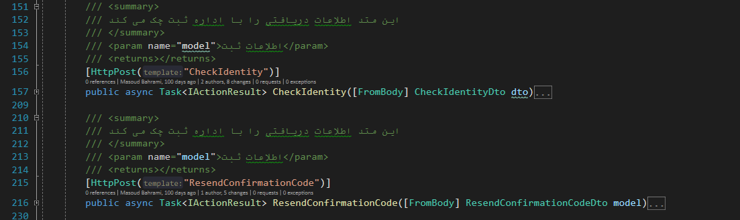
Why comments are evil?!

Slide 5
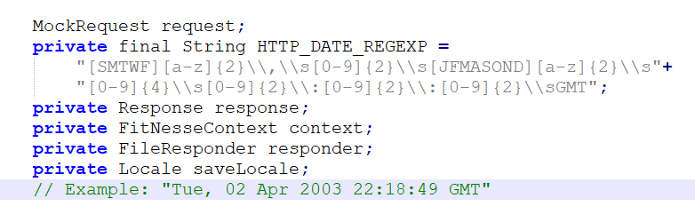
Why comments are evil?!

Slide 6
Comments don’t compensate for bad code
Truth can only be found in one place: the code.
Comments Do Not Make Up for Bad Code
Rather than spend your time writing the comments that explain the mess you’ve made, spend it cleaning that mess.

Slide 7
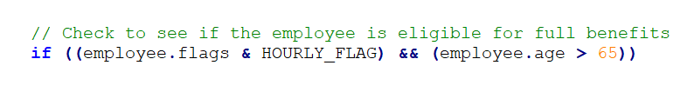

Explain Yourself in Code
In many cases it’s simply a matter of creating a function that says the same thing as the comment you want to write.
Or this?
Don’t Use a Comment When You Can Use a Function or a Variable

Slide 8
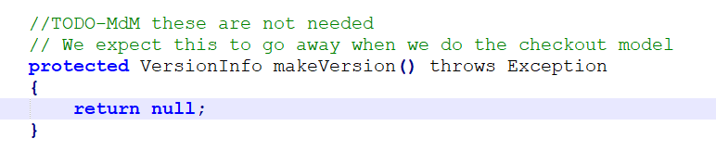
TODO Comments
It is sometimes reasonable to leave “To do” notes in the form of //TODO comments.
In the following case, the TODO comment explains why the function has a degenerate implementation and what that function’s future should be.

Slide 9
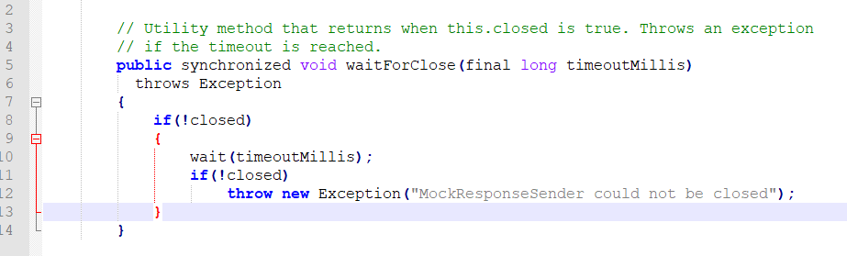
Redundant Comments
The comment probably takes longer to read than the code itself.

Slide 10
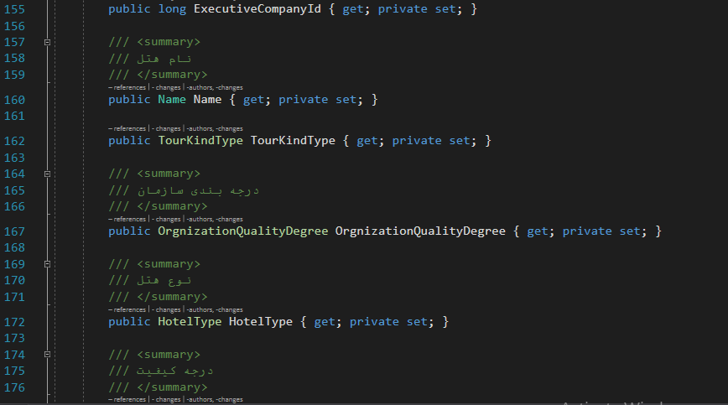
Redundant Comments

Slide 11
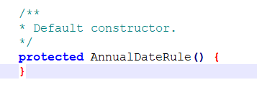
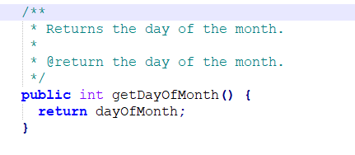
Noise Comments

Slide 12
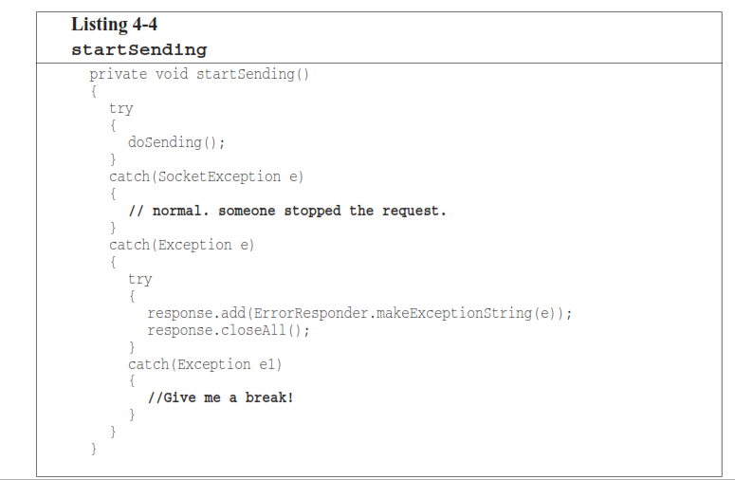
Rather than venting in a worthless and noisy comment, the programmer should have
recognized that his frustration could be resolved by improving the structure of his code

Slide 13
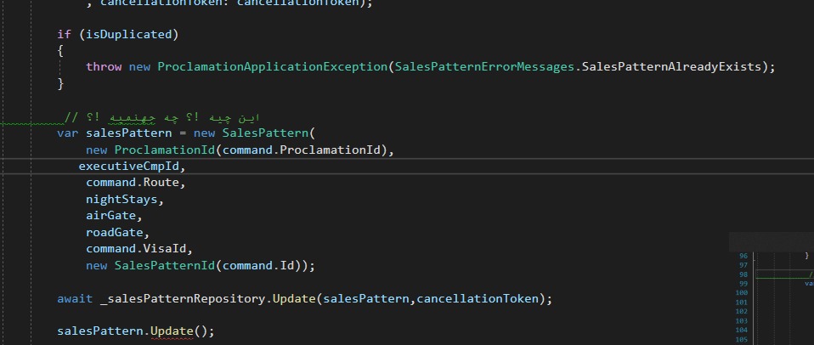

Slide 14
Closing Brace Comments
Sometimes programmers will put special comments on closing braces.
Although this might make sense for long functions with deeply nested structures, it clutters the kind of small and encapsulated functions that we prefer.
So if you ﬁnd yourself wanting to mark your closing braces, try to shorten your functions instead.

Slide 15
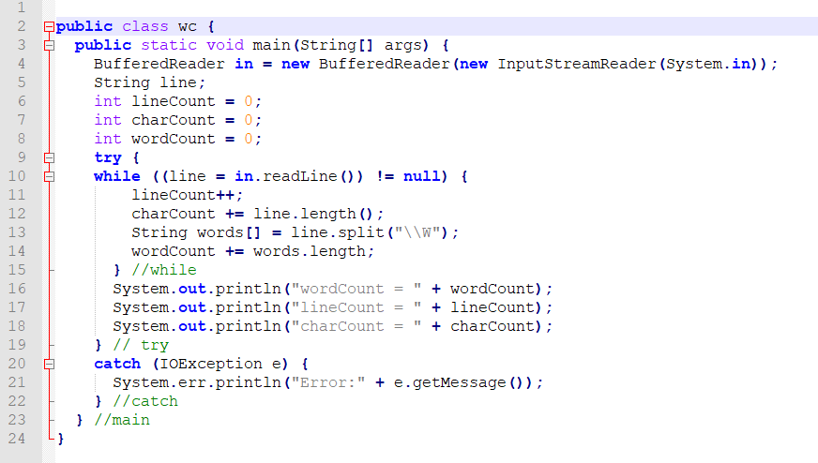

Slide 16
Commented-Out Code
This one can be scary. Others who see that commented-out code won’t have the courage to delete it. They’ll think it is there for a reason and is too important to delete.
So commented-out code gathers like dregs at the bottom of a bad bottle of wine.

Slide 17
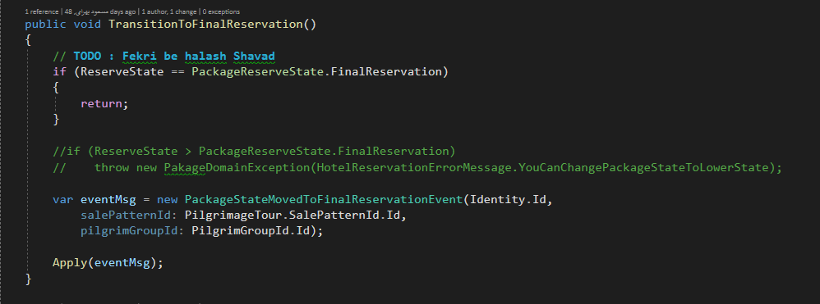
Commented-Out Code

Slide 18
Formatting
When people look under the hood, we want them to be impressed with the neatness, consistency, and attention to detail that they perceive.
You should take care that your code is nicely formatted.
You should choose a set of simple rules that govern the format of your code, and then you should consistently apply those rules.
If you are working on a team, then the team should agree to a single set of formatting rules and all members should comply.

Slide 19
The Purpose of Formatting
Code formatting is about communication, and communication is the professional developer’s ﬁrst order of business.
Perhaps you thought that “getting it working” was the ﬁrst order of business for a professional developer. I hope by now, however, that these talks have disabused you of that idea.
The functionality that you create today has a good chance of changing in the next release, but the readability of your code will have a profound effect on all the changes that will ever be made.

Slide 20
Vertical Formatting
How big should a source ﬁle be? Small ﬁles are usually easier to understand than large ﬁles are.
The Newspaper Metaphor
We would like a source ﬁle to be like a newspaper article.
The name should be simple.
The topmost parts of the source ﬁle should provide the concepts and algorithms.
Detail should increase as we move downward, until at the end we ﬁnd the lowest level functions and details in the source ﬁle.

Slide 21
Vertical Openness Between Concepts
Nearly all code is read left to right and top to bottom.
Each line represents an expression or a clause, and each group of lines represents a complete thought. Those thoughts should be separated from each other with blank lines.

Slide 22
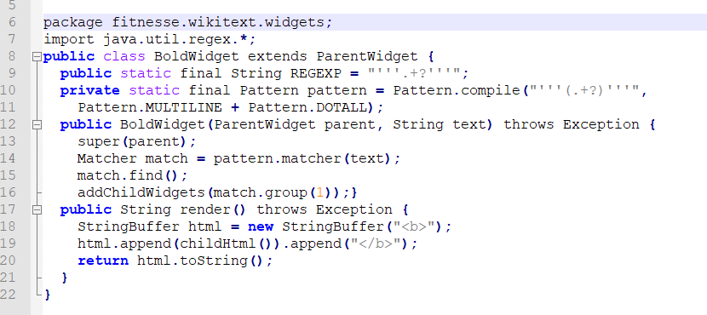
Vertical Openness Between Concepts

Slide 23
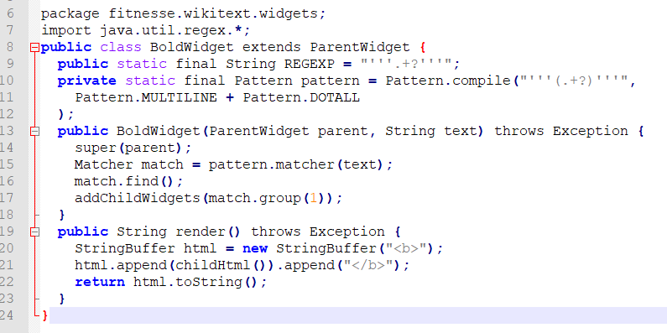
Vertical Openness Between Concepts
The difference between these two listings is a bit of vertical openness

Slide 24
Vertical Density
If openness separates concepts, then vertical density implies close association. So lines of code that are tightly related should appear vertically dense.
Notice how the useless comments in next example break the close association of the two instance variables.

Slide 25
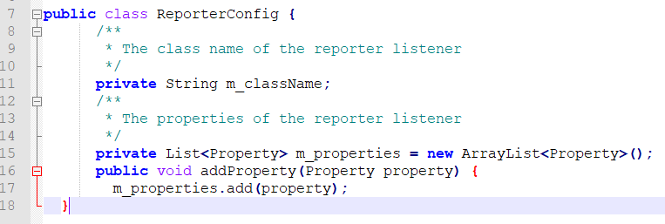
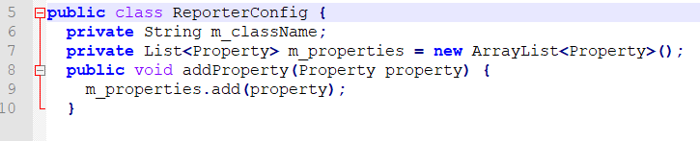

Slide 26
Vertical Distance
Have you ever chased your tail through a class, hopping from one function to another, scrolling up and down the source ﬁle, trying to divine how the functions relate and operate, only to get lost in a rat’s nest of confusion?
Have you ever hunted up the chain of inheritance for the deﬁnition of a variable or function?
This is frustrating because you trying to understand what the system does, but you are spending your time and mental energy on trying to locate and remember where the pieces are.
Concepts that are closely related should be kept vertically close to each other.

Slide 27
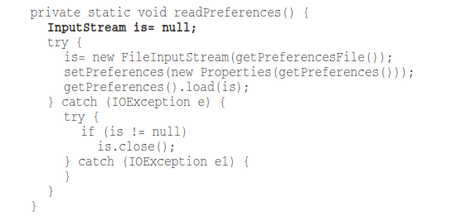
Vertical Distance: Variable Declarations
Variables should be declared as close to their usage as possible.

Slide 28
Instance Variable
Instance variables, on the other hand, should be declared at the top of the class.
Everybody should know where to go to see the declarations.

Slide 29
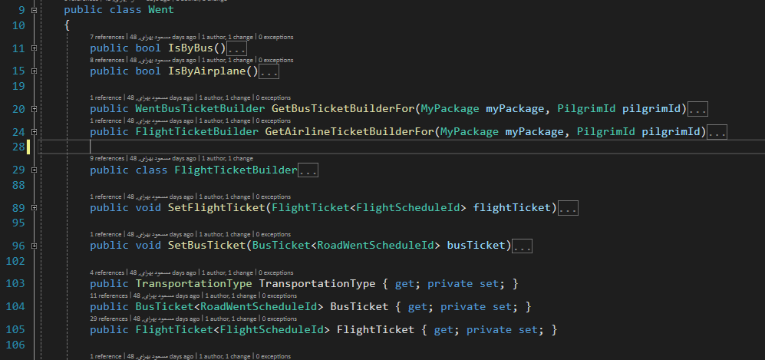
Instance Variable

Slide 30
Dependent Functions
If one function calls another, they should be vertically close, and the caller should be above the callee, if at all possible. This gives the program a natural ﬂow.

Slide 31
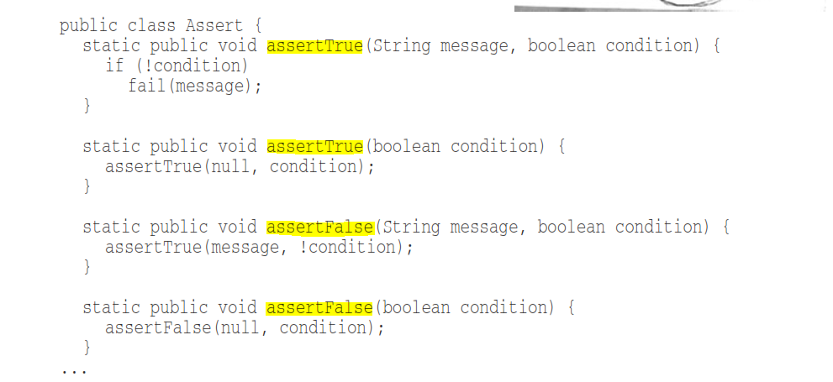
Conceptual Afﬁnity
These functions have a strong conceptual afﬁnity because they share a common naming scheme and perform variations of the same basic task.

Slide 32
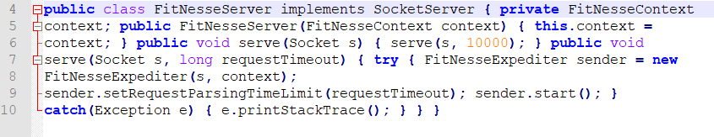
Indentation
To make the hierarchy of scopes visible, we indent the lines of source code in proportion to their position in the hierarchy.

Slide 33
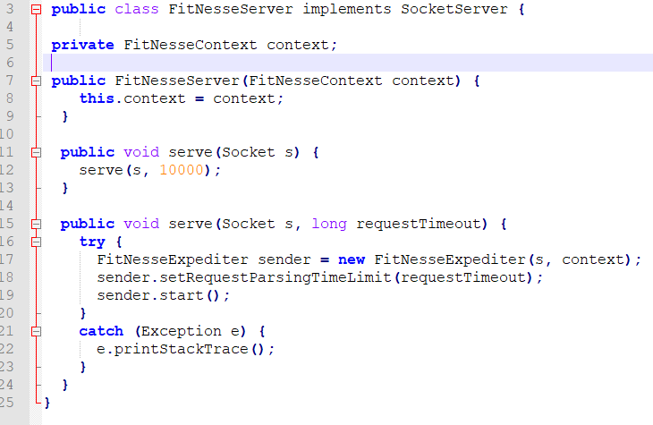
Indentation

Slide 34
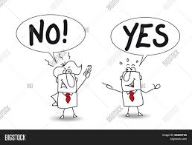
Team Rules
A team of developers should agree upon a single formatting style, and then every member of that team should use that style.
We want the software to have a consistent style. We don’t want it to appear to have been written by a bunch of disagreeing individuals.

